Slide 1
IT Security and Penetration Testing
Chapter 7
Spoofing

Slide 2
Objectives
Understand the mechanics of spoofing
Describe the consequences of spoofing
Define various types of spoofing
List and describe some spoofing tools
Learn how to defend against spoofing
Computer Security and Penetration Testing

Slide 3
Spoofing
Spoofing
  A sophisticated way to authenticate one machine to another by using forged packets
  Misrepresenting the sender of a message to cause the human recipient to behave a certain way
Two critical issues for internetworked systems
  Trust
  Authentication
Computer Security and Penetration Testing

Slide 4
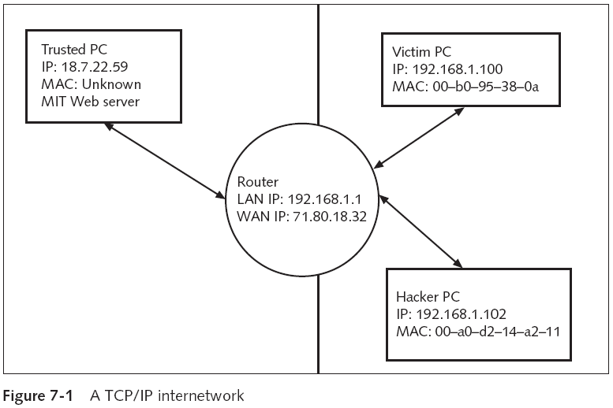
Spoofing (continued)
Computer Security and Penetration Testing

Slide 5
Spoofing (continued)
Authentication is less critical when there is more trust
  A computer can be authenticated by its IP address, IP host address, or MAC address
TCP/IP has a basic flaw that allows IP spoofing
  Trust and authentication have an inverse relationship
  Initial authentication is based on the source address in trust relationships
  Most fields in a TCP header can be changed (forged)
Computer Security and Penetration Testing

Slide 6
The Process of an IP Spoofing Attack
A successful attack requires more than simply forging a single header
  Requires sustained dialogue between the machines for a minimum of three packets
IP takes care of the transport between machines
  But IP is unreliable
  TCP is more reliable and has features for checking received packets
TCP uses an indexing system to keep track of packets and put them in the right order
Computer Security and Penetration Testing

Slide 7
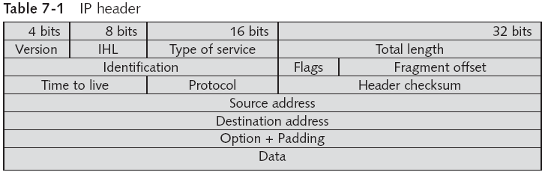
The Process of an IP Spoofing Attack (continued)
Computer Security and Penetration Testing

Slide 8
The Process of an IP Spoofing Attack (continued)
To spoof a trusted machine relationship, the attacker must:
  Identify the target pair of trusted machines
  Anesthetize the host the attacker intends to impersonate
  Forge the address of the host the attacker is pretending to be
  Connect to the target as the assumed identity
  Accurately guess the correct sequence
Computer Security and Penetration Testing

Slide 9
The Process of an IP Spoofing Attack (continued)
You can use any network protocol analyzer to monitor your LAN
You can anesthetize, or stun, the host that you want to impersonate
  By performing a SYN flood (or SYN attack), Ping of Death, or some other denial-of-service attack
Computer Security and Penetration Testing

Slide 10
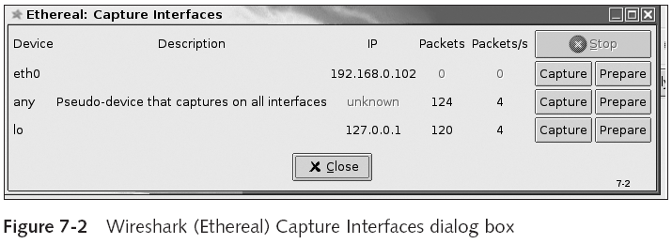
The Process of an IP Spoofing Attack (continued)
Computer Security and Penetration Testing

Slide 11
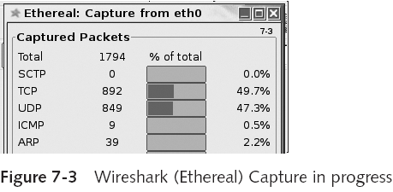
The Process of an IP Spoofing Attack (continued)
Computer Security and Penetration Testing

Slide 12
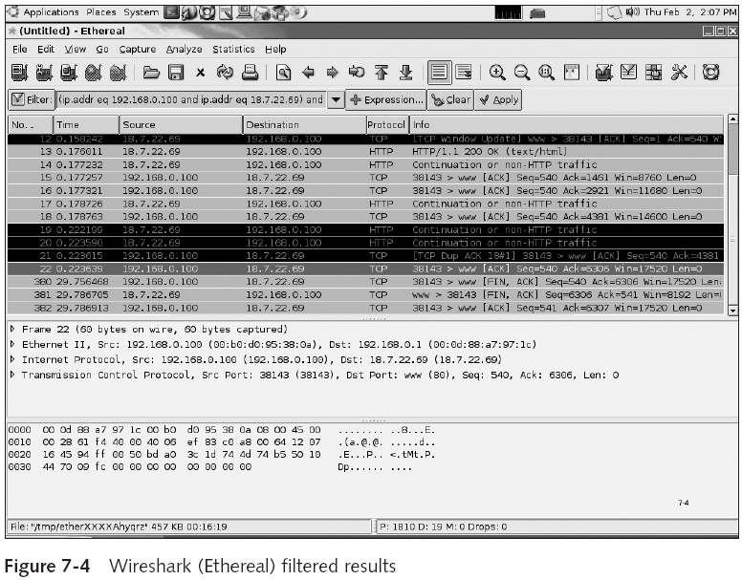
Computer Security and Penetration Testing

Slide 13
The Process of an IP Spoofing Attack (continued)
Forging the address of the stunned host could be done with the same utility
  Used to stun the trusted machine
Big problem is guessing something close to the correct incremented victim-side sequence number
  ISNs are not random, so the guess is not random
Sequence numbers start at 1 when the machine is booted up and incremented by fixed values
  See Table 7-2
Computer Security and Penetration Testing

Slide 14
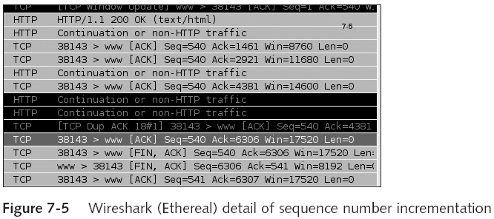
The Process of an IP Spoofing Attack (continued)
Computer Security and Penetration Testing

Slide 15
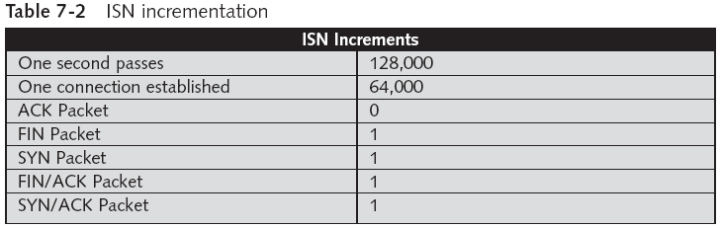
The Process of an IP Spoofing Attack (continued)
Computer Security and Penetration Testing

Slide 16
The Process of an IP Spoofing Attack (continued)
Once the hacker has put the trusted machine to sleep with a SYN attack
  Sends a SYN packet to the victim machine
Hacker should connect to the victim machine several times on port 23 or 25
  To get an idea of how quickly the ISN advances
Attacker also needs to deduce the packet’s round-trip time (RTT)
When the attack is done, the trusted machine must be released and returned to normal
Computer Security and Penetration Testing

Slide 17
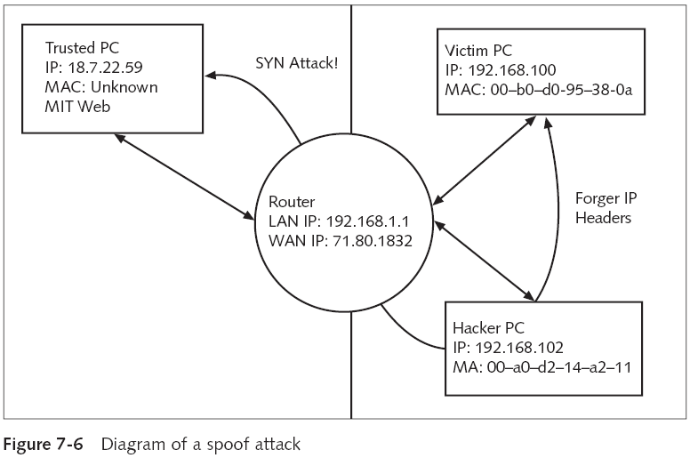
Computer Security and Penetration Testing

Slide 18
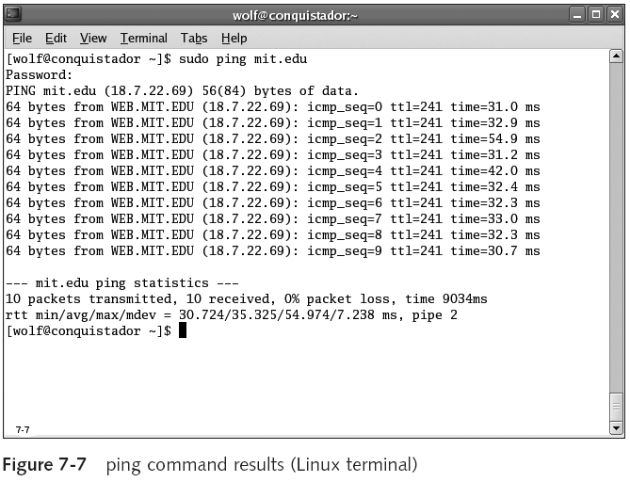
Computer Security and Penetration Testing

Slide 19
Costs of Spoofing
Costs to the victims of successful spoofing attacks
  Are tied to the amount of information that was copied and the sensitivity of the data
Tangible and intangible losses
Successful spoof attacker usually leaves back door
  To get back in later
Computer Security and Penetration Testing

Slide 20
Kinds of Tangible Costs
Economic Loss
  May occur when valuable data is lost or duplicated
  Surreptitious nature of a successful spoofing attack
    Company might not know what happened or when
Strategic Loss
  Loss of strategic data that outlines events planned for the future
  Could lead to loss of both money and goodwill for the spoofed company
Computer Security and Penetration Testing

Slide 21
Kinds of Tangible Costs (continued)
General Data Loss
  Usually has less of an impact than the first two categories of losses
  Comes from unsecured documents used by employees
    Working on various projects or engaged in the day-to-day business of the company
Computer Security and Penetration Testing

Slide 22
Types of Spoofing
Main categories of spoofing include the following:
  Blind spoofing
  Active spoofing
  IP spoofing
  ARP (Address Resolution Protocol) spoofing
  Web spoofing
  DNS (Domain Name System) spoofing
Computer Security and Penetration Testing

Slide 23
Blind Spoofing
Any kind of spoofing where only one side of the relationship under attack is in view
Hacker is not aware of all network conditions
  But uses various means to gain access to the network
Computer Security and Penetration Testing

Slide 24
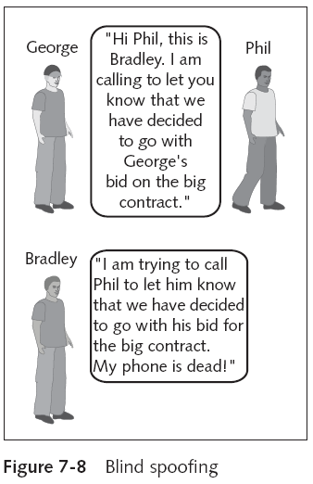
Computer Security and Penetration Testing

Slide 25
Active Spoofing
Hacker can see both parties, observe the responses from the target computer, and respond accordingly
Hacker can perform various exploits, such as
  Sniffing data, corrupting data, changing the contents of a packet, and even deleting some packets
Computer Security and Penetration Testing

Slide 26
IP Spoofing
Consists of a hacker accessing a target disguised as a trusted third party
Can be performed by hackers through either blind or active methods of spoofing
Computer Security and Penetration Testing

Slide 27
ARP Spoofing
Modifying the Address Resolution Protocol (ARP) table for hacking purposes
ARP table stores the IP address and the corresponding Media Access Control (MAC) address
Router searches the ARP table for the destination computer’s MAC address
ARP spoofing attack involves detecting broadcasts, faking the IP address
  And then responding with the MAC address of the hacker’s computer
Computer Security and Penetration Testing

Slide 28
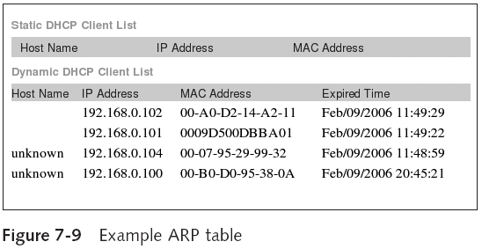
ARP Spoofing (continued)
Computer Security and Penetration Testing

Slide 29
Web Spoofing
Hacker spoofs an IP address through a Web site
Hacker can transfer information or get information
Hacker can spoof using a strategy
  That ensures that all communication between the Web site and the user is directed to the hacker’s computer
Hacker may also falsely acquire a certificate used by a Web site
Computer Security and Penetration Testing

Slide 30
DNS Spoofing
Hacker changes a Web site’s IP address to the IP address of the hacker’s computer
Altering the IP address directs the user to the hacker’s computer
User is accessing the hacker’s computer
  Under the impression that he or she is accessing a different, legitimate, site
Computer Security and Penetration Testing

Slide 31
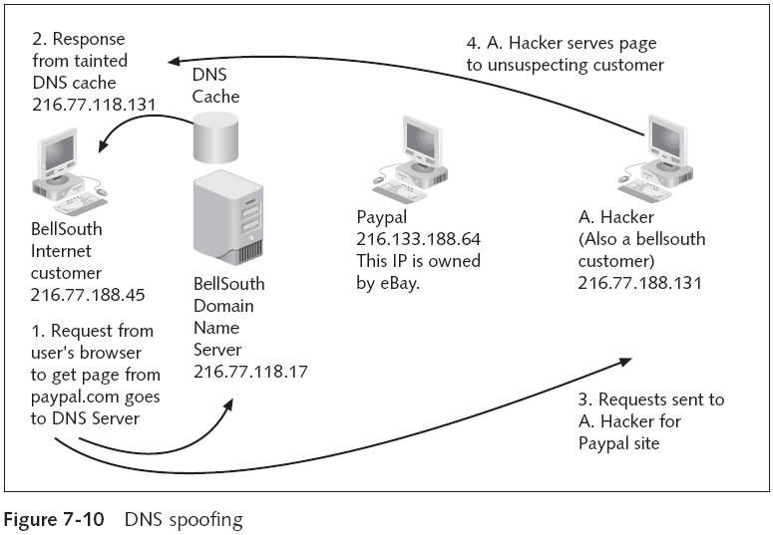
Computer Security and Penetration Testing

Slide 32
Spoofing Tools
This section covers the following spoofing tools and their uses:
  Apsend
  Ettercap
  Arpspoof
Computer Security and Penetration Testing

Slide 33
Apsend
Supported protocols: TCP, IP, UDP, and ICMP
Used to test firewalls and other network applications
Can perform the following spoofing attacks
  SYN flood attack
  DoS attack against tcpdump on a UNIX-based system
  UDP flood attack,
  ping flood attack
  Socket functions
  Time-to-live (TTL) attack
  Type-of-service (ToS) attack
Computer Security and Penetration Testing

Slide 34
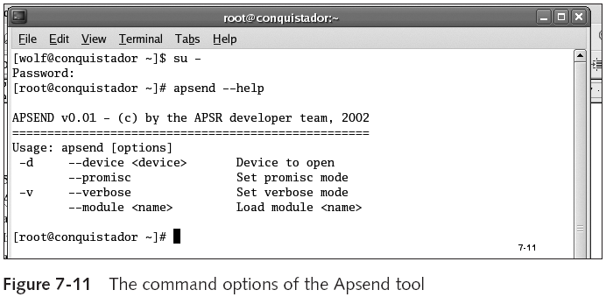
Apsend (continued)
Computer Security and Penetration Testing

Slide 35
Ettercap
Provides a list of options that can be used to perform various spoofing operations
  See Table 7-3
Hacker selects the action to perform from multiple options, including
  ARP poisoning
  Viewing interface
  Packet filtering/dropping
Computer Security and Penetration Testing

Slide 36
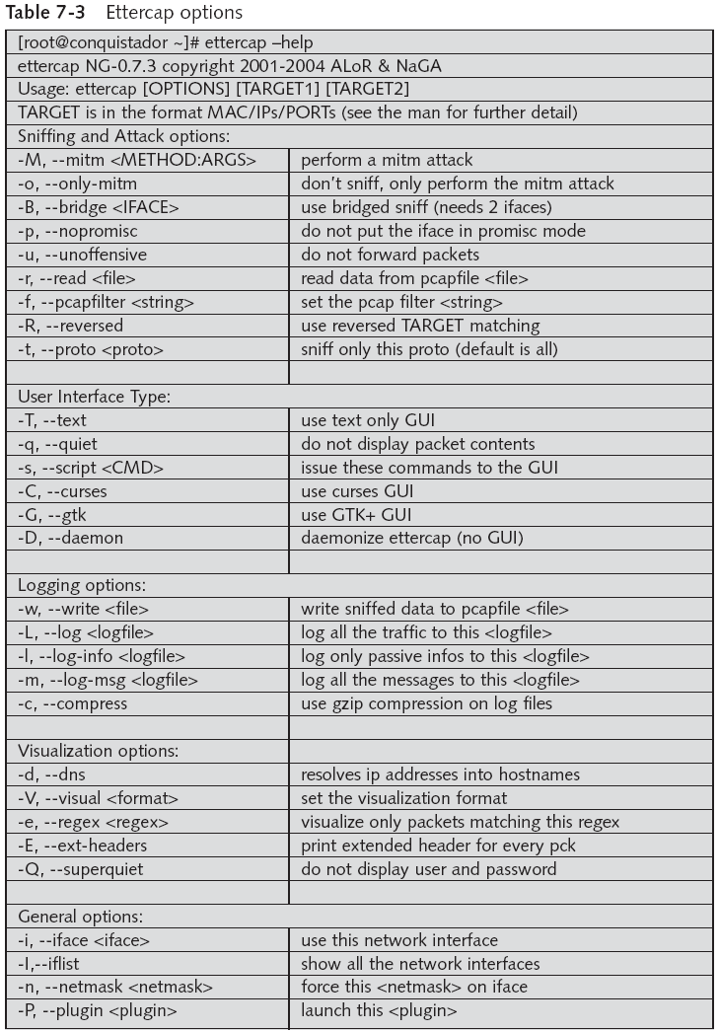
Computer Security and Penetration Testing

Slide 37
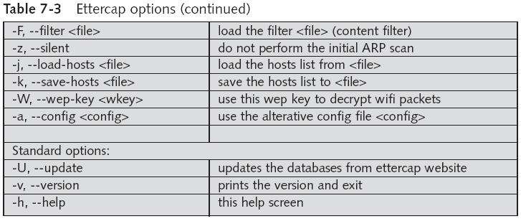
Ettercap (continued)
Computer Security and Penetration Testing

Slide 38
Ettercap (continued)
Ettercap works on the following platforms:
  Linux 2.0.x - 2.4.x
  FreeBSD 4.x
  OpenBSD 2. [789] 3.0
  NetBSD 1.5
  Mac OS X (Darwin 1.3. 1.4 5.1)
Computer Security and Penetration Testing

Slide 39
Arpspoof
Part of the dsniff suite
Can be used to spoof ARP tables
General syntax
  arpspoof [-i interface] [-t target] host
Changes the MAC address specified for the IP address of the destination computer
  In the ARP table of the source computer
Computer Security and Penetration Testing

Slide 40
Prevention and Mitigation
To avoid or defend against IP spoofing:
  Wherever possible, avoid trust relationships that rely upon IP address only
  On Windows systems—If you cannot remove it, change the permissions on the $systemroot$\hosts file to allow read only access
  On Linux systems—Use TCP wrappers to allow access only from certain systems
  Install a firewall or filtering rules
  Use encrypted and secured protocols like IPSec
  Use random ISNs
Computer Security and Penetration Testing

Slide 41
Prevention and Mitigation (continued)
To avoid or defend against ARP poisoning:
  Use methods to deny changes without proper authorization to the ARP table
  Employ static ARP tables
  Log changes to the ARP table
Computer Security and Penetration Testing

Slide 42
Summary
Spoofing definitions
Trust and authentication are at the heart of internetworking
A successful IP spoofing attack requires a complete, sustained dialogue between the machines for a minimum of three packets
Steps to spoof a trusted machine relationship
The costs to the victims of successful spoofing attacks are tied to the amount of information that was copied and the sensitivity of the data
Computer Security and Penetration Testing

Slide 43
Summary (continued)
Types of spoofing: blind spoofing, active spoofing, IP spoofing, ARP spoofing, Web spoofing, and DNS spoofing
Apsend, Ettercap, and Arpspoof are three common spoofing tools
To avoid or defend against IP spoofing, avoid IP-address-based trust relationships, install a firewall, use encrypted protocols, and use random ISNs
Computer Security and Penetration Testing

Slide 44
Summary (continued)
To avoid or defend against ARP poisoning, use methods to deny changes without proper authorization to the ARP table, employ static ARP tables, and log changes to the ARP table
Computer Security and Penetration Testing

